Slide 1

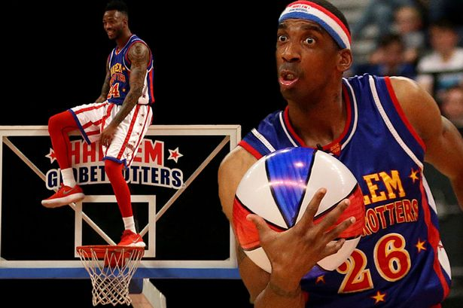

Slide 2


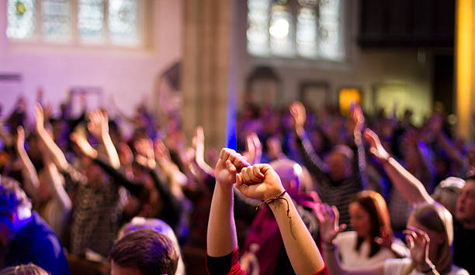
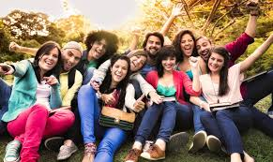

Groups
NOTE:
To change images on this slide, select a picture and delete it. Then click the Insert Picture icon
in the placeholder to insert your own image.
Corporates
Universities and Colleges
Sports Clubs and Associations

Slide 3

CORPORATES
Minimum tickets (25+ Tickets) for 10% discount off every ticket
Free advertising of their products
Free food vouchers
Free Harlem T-shirts
Free Globetrotters labeled coffee cup and mugs
Gift cards along with recognition and an opportunity to meet and take photos with the Globetrotters
Thursday, October 15 7:00 PM and Friday, October 16 7:00 PM
Corporate Categories
      Banks
      Supermarkets
      Hotels
      Hospital
      Manufacturing companies
Class | Normal | Group(25+PPL)
VIP Floor | $100 | $90
Lower (Center) | $80 | $72
Lower (Side/End) | $55 | $49.50
Upper Bowl (Side/Center) | $25 | $22.50

Slide 4
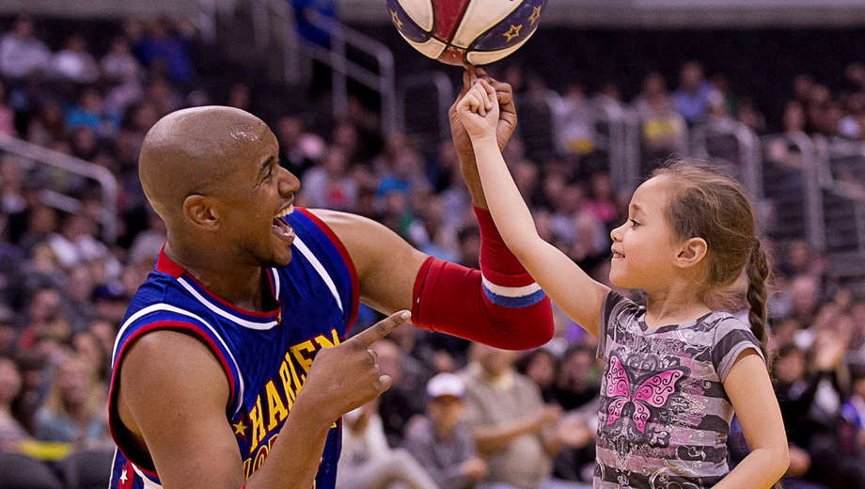
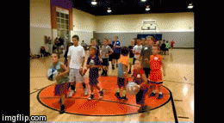
UNIVERSITIES AND COLLEGES
Class | Normal | Group (20+PPL)
VIP Floor | $100 | $80
Lower (Center) | $80 | $64
Lower (Side/End) | $55 | $44
  Minimum tickets (20 + Tickets) for 20% discount off every ticket.
  Free College and university I.D holders
  Globetrotters drawstring bags with highlighter pens
  Free Globetrotters labels stick phone grip
  Globetrotters T-shirts caps and visors
  Recognition and an opportunity to meet the Globetrotters
  Music and Public address communications
  Saturday, October 17 3:00 PM, 7:00 PM
Group categories
Student government organizations
Religious and spiritual organizations.
Recreation and sports organizations.
Political or multicultural organizations.
Media and publication organizations.
Community service organizations.
Academic and educational organizations.
Upper Bowl (Side/Center) | $25 | $20
Upper Bowl (End) | $15 | $12

Slide 5
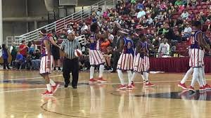
SPORTS ASSOCIATION
Class | Normal | Group (30 + ppl)
VIP Floor | $100 | $88
Lower (Center) | $80 | $70.4
Lower (Side/End) | $55 | $48.4
Minimum tickets (30+ Tickets) for 22% discount off every ticket
Free Harlem Globetrotters T-shirts and caps and visors
Basketball ball merit badge and signage.
Free medical screening
Globetrotter Sports Bags
Free Globetrotter water bottles
Opportunity to meet and take photos with the globetrotters.
80% discounted food vouchers
Sunday, October 18 3:00 PM, 7:00 PM
Upper Bowl (Side/Center) | $25 | $22
Upper Bowl (End) | $15 | $13.2

